Slide 1
Predictive models for survivability and adverse drug reactions
Based on FAERS and drugbank public datasets
Hossein Amini, Ph.D. candidate, industrial engineering
Majid jaberi, PhD, Iccm
Kansas State University
Oct 10

Slide 2




Background
According to global cancer statistics for 2018 (GLOBOCAN) there is an estimation of 9.6 million death records due to cancer in 2018.
Lung cancer has been seen as the leading cancer among both men and women. In the second place, breast cancer is the major cancer among all type of cancers and is the first deadliest cancer between women in US.
Breast cancer does not target only females as nearly 2000 male cases were diagnosed between 2003 and 2008.
Detecting the risk level associated with the patient can help the treatment procedure as risky patients could be monitored more.

Slide 3

Background
Traditionally, disease diagnosis and prognosis were both assessed by expert physicians based on symptoms reported by patients and lab results.

Slide 4

Background
The expertise of this knowledge was built upon years of observations and training.
However, the accuracy of expert’s opinion cannot be guaranteed and sometimes experts can make wrong decisions which in cases could be fatal.

Slide 5
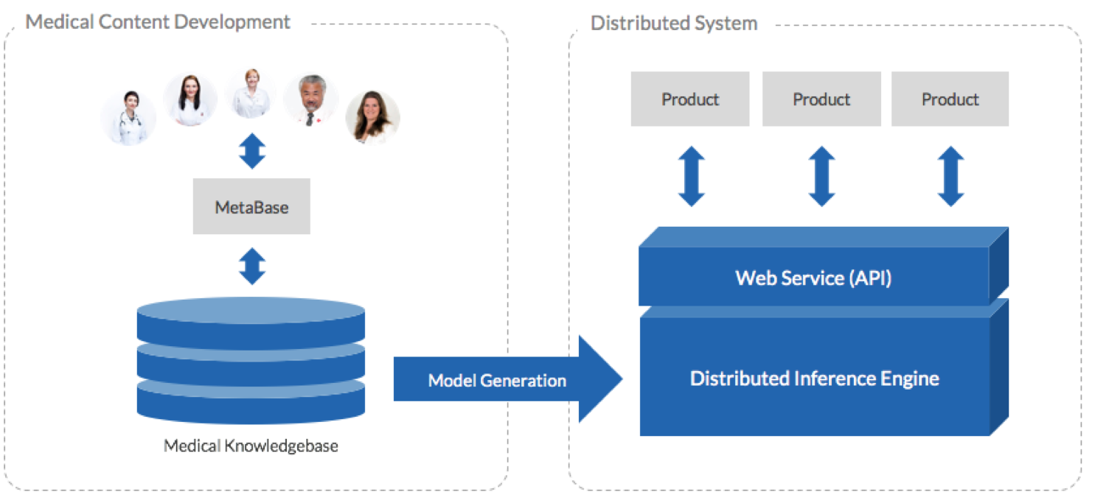
Background
Decision support systems are tools to reduce the diagnosis error.

Slide 6

Background
Especially, data-driven decision support systems in medical science are very popular and large number of researchers are utilizing them.

Slide 7
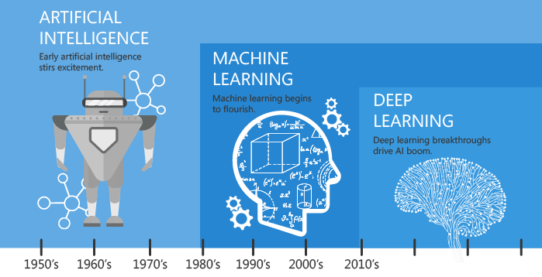
Background
Machine learning (ML) is a subset of artificial intelligence (AI) where data is used to make decisions.

Slide 8

Background

Slide 9
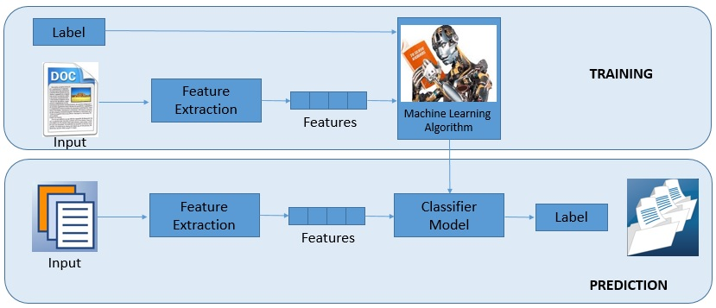
Background
Supervised model

Slide 10
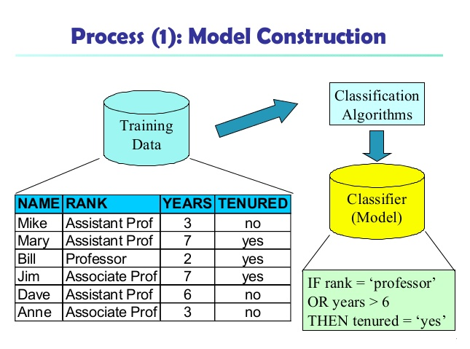
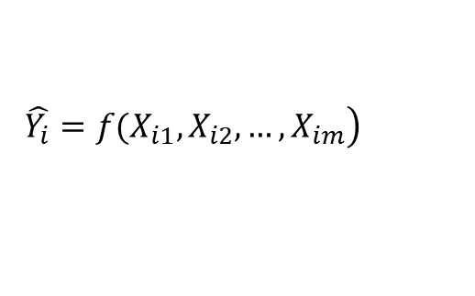
Background
$$\left.\hat{Y_{i}}=f(X_{i1},X_{i2},…,X_{im}\right)$$
Decision Tree
SVM
Bayes Models
Neural Networks
Logistic Regression
...
feature
response

Slide 11
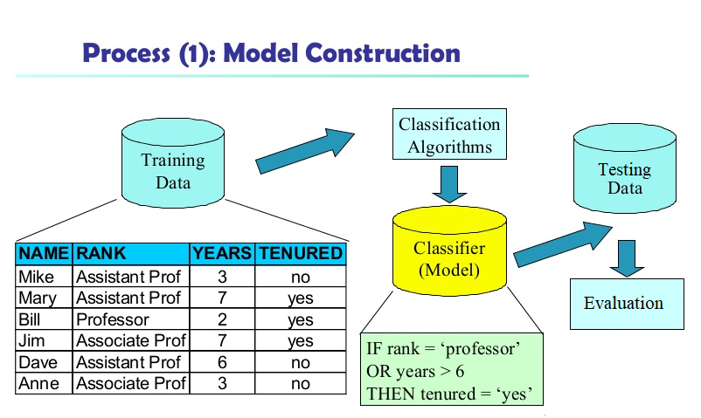
Background

Slide 12
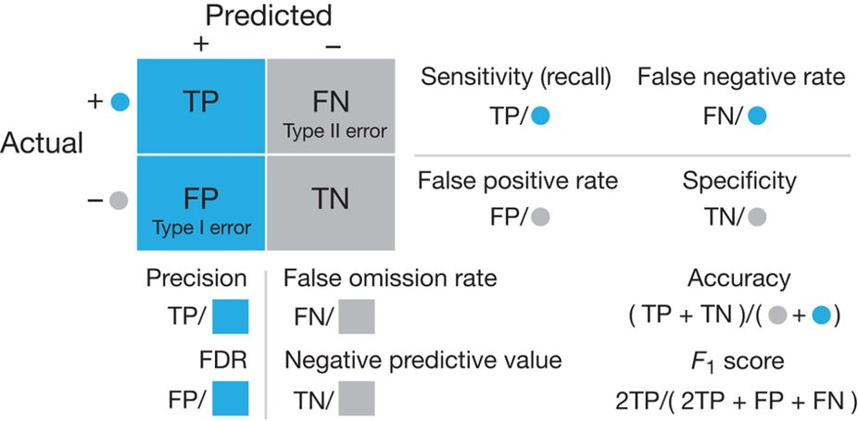
Background
Confusion Matrix

Slide 13
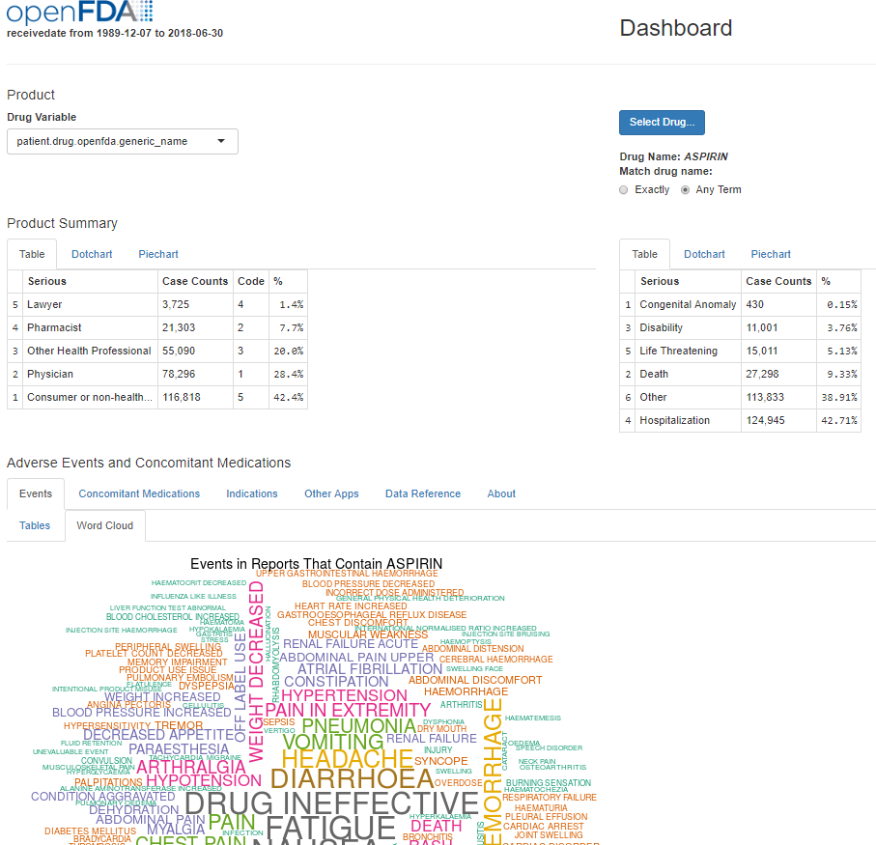
Dataset
FAERS (FDA Adverse Event Report System)

Slide 14

Dataset
Data cleaning is 80% of the job
FAERS (FDA Adverse Event Report System) dataset contains:
Patient info: patient id, age, gender, weight, country,…
Drug info: name, id, sequence, dosage, company,…
Visit info: visit id
Outcomes: death, hospitalization, life-threating, disability, other serious issues,..
Reactions
Patient | Drug | Reaction | … | Death | Hospitalization | …
X1 | docetaxel | Nausea | … | 1 | 1 | …
X2 | faslodex | Fever | … | 0 | 1 | …
X3 | Arimidex | arthralgia | … | 0 | 0 | …

Slide 15

From here, we focus on patients diagnoses with breast cancer

Slide 16
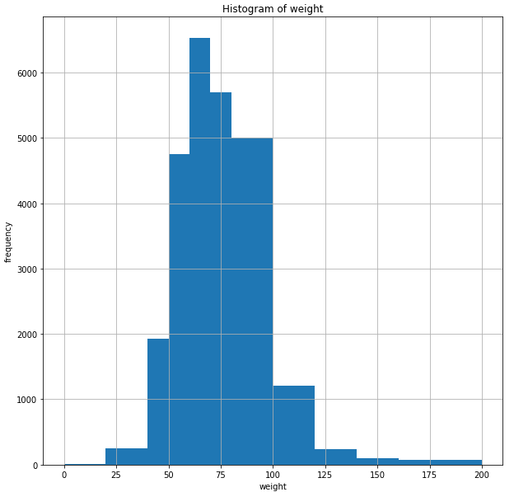
Dataset
Histogram of weight of patients

Slide 17
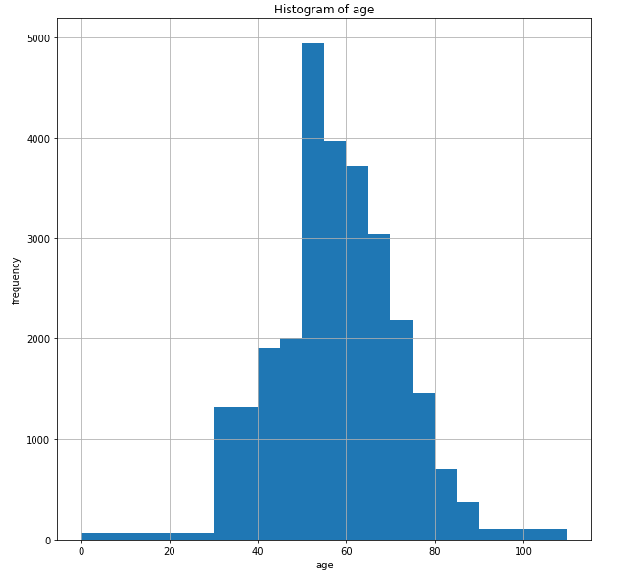
Dataset
Histogram of age of patients

Slide 18
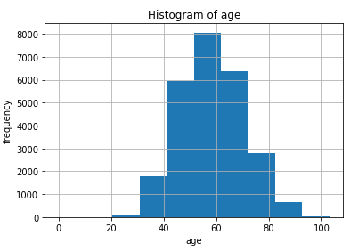
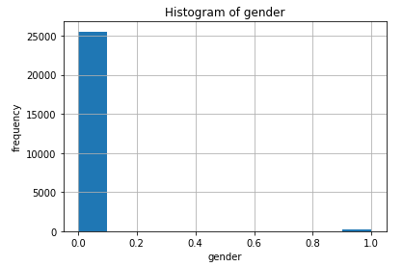


Dataset
Histogram of gender of patients

Slide 19
Dataset
Plot of reactions

Slide 20
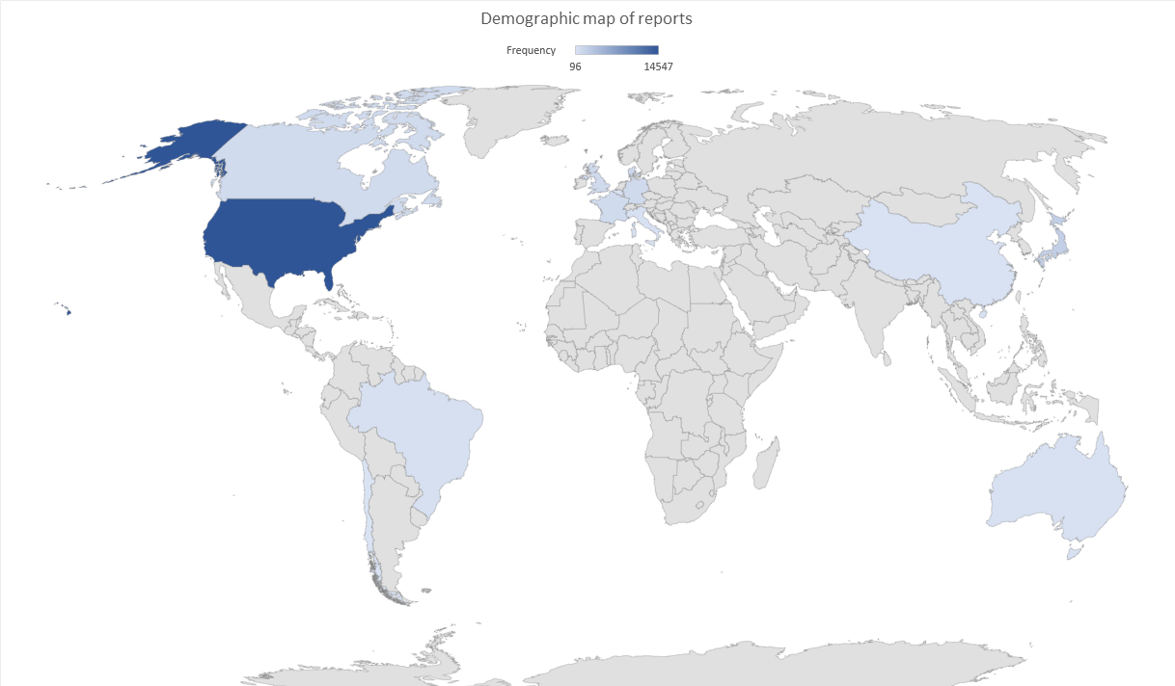
Dataset
Demographic map

Slide 21

Predictive models – survivability
Predictive models have used features as:
Age (numeric)
Gender (categorical)
Weight (numeric)
Taken drugs (categorical)
Disease (categorical) (In survivability model is fixed)
Death record is the response :0 or 1

Slide 22
Predictive models - survivability
Predictive models do not work with strings (like reaction “nausea”).
The strings need to be represented by numbers. However, this simply makes confusion in predictive models.
Therefore, we have further treated the categorical features as binary features. For example, a feature such as disease with thousands of records, has been broken into pieces like:
cancer-yes, cancer-no, osteopenia-yes, osteopenia-no ,…
Advantage: Easy to understand
Disadvantage: Higher memory usage, large matrix
Other approaches: Feature hashing, high/less importance categories, hybrid models…
Advantage: Less memory usage
Disadvantage: Hard to understand
This makes a huge matrix with many columns (computationally columns are more complex than rows!)
It has increased the number of columns from 13 to 617

Slide 23
Predictive models - survivability
Predictive model on patients having Breast cancer (male & female):
A Decision tree has been trained on 90% of all available data (25769 records). 10% of the records have been reserved for evaluation of the model. (for all stages)
The predictive model acquires 95.6% accuracy with following confusion matrix:
This means that, in the testing dataset (2577 records), the model correctly predicted 2240 records in no-death group and 226 records in death group. However, the model has misclassified 86 records in death group (while they are not actually in death group) and 25 records in no-death group (while they are actually in death group).
Actual | Prediction
 | No death | Death
No death | 2240 | 86
Death | 25 | 226

Slide 24

Predictive models - survivability
Predictive model on patients having Breast cancer (male & female):
Random forest has been trained on 90% of all available data (25769 records). 10% of the records have been reserved for evaluation of the model. (100 trees, class-weight-balance)
The predictive model acquires 96.3% accuracy with following confusion matrix:
This means that, in the testing dataset (2577 records), the model correctly predicted 2256 records in no-death group and 226 records in death group. However, the model has misclassified 70 records in death group (while they are not actually in death group) and 25 records in no-death group (while they are actually in death group).
Actual | Prediction
 | No death | Death
No death | 2256 | 70
Death | 25 | 226

Slide 25
Predictive models - survivability

Slide 26
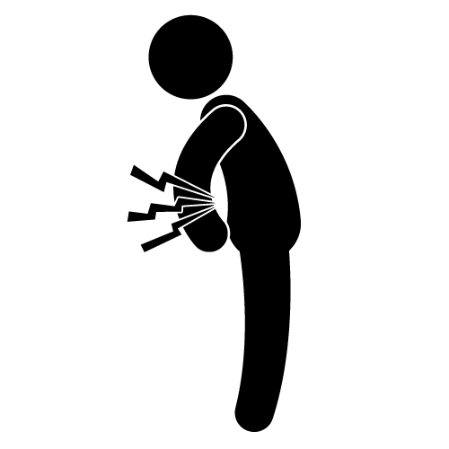



Predictive models - survivability
Random Forest is further selected due to better metrics.
Random Forest is a collection of decision trees which combines them to obtain a better result.
The same procedure has been done for other outcomes :
Hospitalization
Life Threating
Disability
Other serious issues

Slide 27
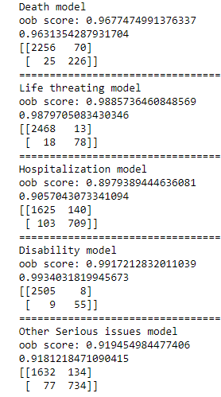
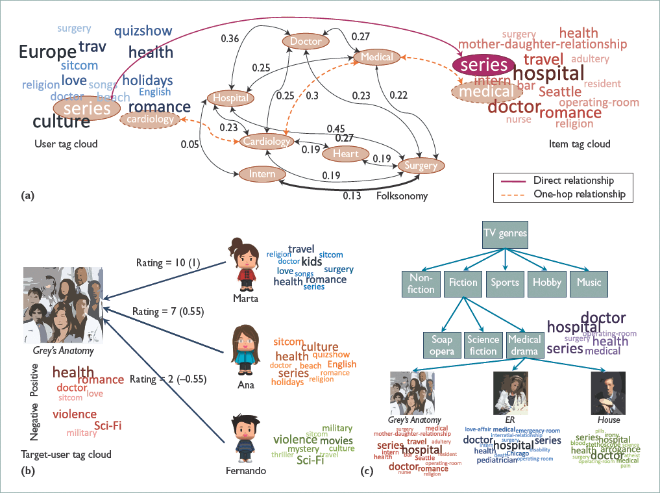
Recommender System

Slide 28
Recommender System
A drug recommender system on patients with “Breast Cancer “:
Using predictive models, a recommender system on patients suffering breast cancer is made based on outcome of drugs administrated (outcomes are records such as death, serious issue, hospitalization, …).
The model is built using age, gender, weight, and drugs. Based on these features, a score (weighted summation of death probability, hospitalization probability , …) is generated.
Weights are as: (subjective)
10 for death
3 for life threating
2 for hospitalization
1.5 for disability
1 for other serious issues
Then, based on given age, weight, and gender and having a knowledge of disease (breast cancer), a drug is recommended to a patient.
In addition, a ranked top 5 listed of drugs is shown as well.

Slide 29
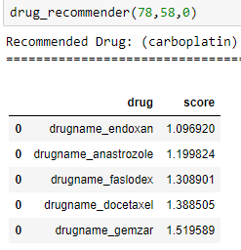
Recommender System
For example, for a female patient age 78 and weight 58kg, the recommended drug is :carboplatin
The list of top 5 drugs are as:

Slide 30
Correlation Analysis
Correlation analysis on patients having breast cancer (stage 1):
Using data mining approaches, a correlation of records with serious outcomes (no death record) and drugs, weight, gender, age, and reactions has been obtained.
Drugs:
Drug Aromasin has the highest correlation (58%)
Aromasin has been repeated 2 times in total(20) and only to patients with serious issues.
Arimidex has been repeated 3 times in patients with serious issues.
Drug Herceptin has the lowest correlation (-21%).
Herceptin has been repeated 3 times only with patients with no serious issue.
Reactions:
“trigeminal neuralgia” has the highest correlation (40%)
“palpitations” has the least correlation (-17%).
Age and weight have -7% and -35% correlation and gender is NAN (no male).

Slide 31
Correlation Analysis
Correlation analysis on patients having breast cancer (stage 2):
Using data mining approaches, a correlation of records with serious outcomes (no death record) and drugs, weight, gender, age, and reactions has been obtained.
Drugs:
Drug trastuzumab emtansine has the highest correlation (44%)
Trastuzumab emtansine has been repeated 4 times only with patients with serious issues.
Arimidex has the lowest correlation (-24%).
Arimidex has been repeated 29 times in 74 reports and 27 of those times have been for patients with no serious issues.
Reactions:
“neutrophil count decreased” has the highest correlation (44%)
“arthralgia” has the least correlation (-11%).
Age and weight have -2% and 33% correlation and gender is NAN (no male).

Slide 32
Correlation Analysis
Correlation analysis on patients having breast cancer (stage 3):
Using data mining approaches, a correlation of records with serious outcomes (no death record) and drugs, weight, gender, age, and reactions has been obtained.
Drugs:
Drug faslodex has the highest correlation (48%)
Faslodex has been repeated 2 times only for patients with serious outcomes.
radiation therapy has the lowest correlation (-10%).
Radiation therapy has been repeated 7 times only to patients with no serious issues.
Reactions:
“blood oestrogen decreased” has the highest correlation (34%)
“arthralgia” has the least correlation (-7%).
Age and weight have 20% and -0.5% correlation and gender is NAN (no male).

Slide 33
Correlation Analysis
Correlation analysis on patients having breast cancer (stage 4):
Using data mining approaches, a correlation of death records with drugs, weight, gender, age, and reactions has been obtained.
Drugs:
Drug docetaxel has the highest correlation (81%)
Docetaxel has been repeated 2 times only for patients with death record.
Aredia has the lowest correlation (-3%).
Aredia has been repeated 81 times only for patients with no death record.
Reactions:
“Procedural complication” has the highest correlation (57%)
“fatigue” has the least correlation (-1.4%).
Age and weight have 9% and 1% correlation and gender is close to 0.

Slide 34
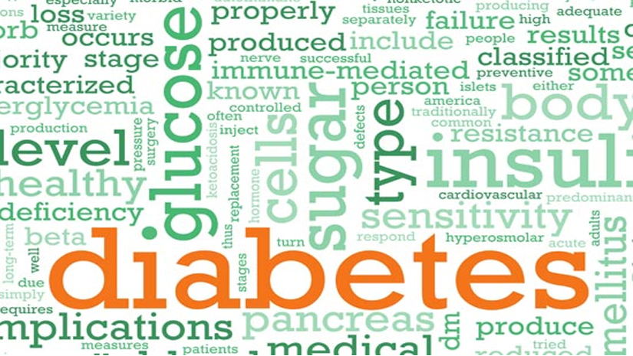



Predictive models on reactions (on all indications)
Now, we are interested to predict the reactions.
Question: After taking the drug?

Slide 35

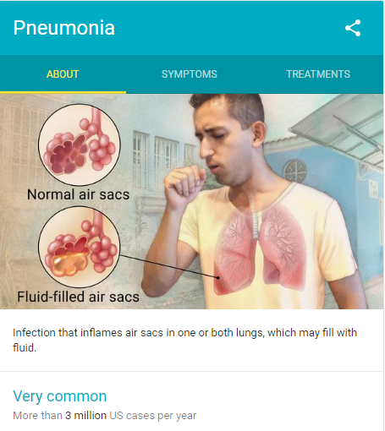
Disease: Rheumatoid arthritis
Reaction: pneumonia
Meaning: Infection that inflames air sacs in one or both lungs, which may fill with fluid.
Pneumonia has been repeated 603 times in 54862 records (with Rheumatoid arthritis).

Slide 36
Predictive models on reactions
Predictive having pneumonia reactions in patients with arthritis indication:
Random forest has been trained on 90% of all available data (54862records). 10% of the records have been reserved for evaluation of the model.
The predictive model acquires 95.4% accuracy with following confusion matrix:
Actual | Prediction
 | No pneumonia | pneumonia
No pneumonia | 5231 | 196
pneumonia | 55 | 5

Slide 37
Predictive models on reactions
Predictive having pneumonia reactions in patients with arthritis indication:
Logistic Regression has been trained on 90% of all available data (54862records). 10% of the records have been reserved for evaluation of the model.
The predictive model acquires 71% accuracy with following confusion matrix:
Actual | Prediction
 | No pneumonia | pneumonia
No pneumonia | 3901 | 1526
pneumonia | 25 | 35

Slide 38
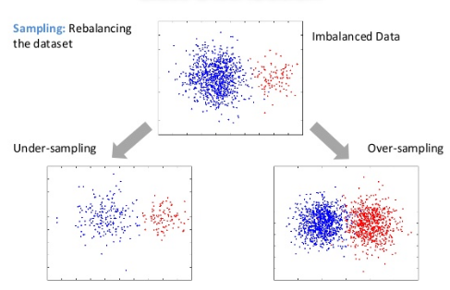
Predictive models on reactions
Predictive having pneumonia reactions in patients with arthritis indication:
The results are based on unbalance nature of the problem
Patients not-having pneumonia | 54259
Patients having pneumonia | 603
 | no- pneumonia | pneumonia
Original training dataset | 48832 | 543
Over Sampling | 48832 | 48832
Under Sampling | 543 | 543

Slide 39
Predictive models on reactions
Predictive having pneumonia reactions in patients with arthritis indication:
Using two important techniques to reduce the false negative value:
Over Sampling
Under Sampling
Under sampling (for random forest):
Actual (Under sampling ) | Prediction
 | No pneumonia | pneumonia
No pneumonia | 3114 | 2313
pneumonia | 22 | 38
Actual (Original) | Prediction
 | No pneumonia | pneumonia
No pneumonia | 5231 | 196
pneumonia | 55 | 5

Slide 40
Predictive models on reactions
Predictive having pneumonia reactions in patients with arthritis indication:
Using two important techniques to reduce the false negative value:
Over Sampling
Under Sampling
Under sampling (for logistic regression):
Actual (Under sampling ) | Prediction
 | No pneumonia | pneumonia
No pneumonia | 3251 | 2176
pneumonia | 18 | 42
Actual (Original) | Prediction
 | No pneumonia | pneumonia
No pneumonia | 3901 | 1526
pneumonia | 25 | 35

Slide 41
Predictive models on reactions
Predictive having pneumonia reactions in patients with arthritis indication:
Using two important techniques to reduce the false negative value:
Over Sampling
Under Sampling
Over sampling (for random forest):
Actual (Over Sampling) | Prediction
 | No pneumonia | pneumonia
No pneumonia | 5395 | 32
pneumonia | 59 | 1
Actual (Original) | Prediction
 | No pneumonia | pneumonia
No pneumonia | 5231 | 196
pneumonia | 55 | 5

Slide 42
Predictive models on reactions
Predictive having pneumonia reactions in patients with arthritis indication:
Using two important techniques to reduce the false negative value:
Over Sampling
Under Sampling
Over sampling (for logistic regression):
Actual (Over Sampling) | Prediction
 | No pneumonia | pneumonia
No pneumonia | 4166 | 1261
pneumonia | 29 | 31
Actual (Original) | Prediction
 | No pneumonia | pneumonia
No pneumonia | 3901 | 1526
pneumonia | 25 | 35

Slide 43
Predictive models on reactions
Predictive having pneumonia reactions in patients with arthritis indication:
Remember negative class numbers!!
Outcome: The features can’t define the response very well.

Slide 44


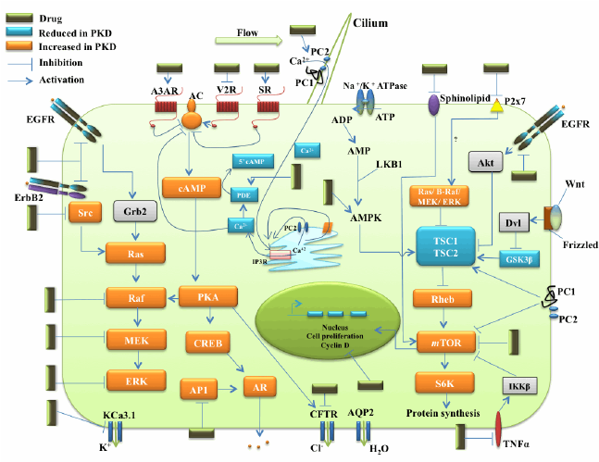
Solution
Add ingredients…(Features)
Drug target
Drug Pathway
A metabolic pathway is a linked series of chemical reactions occurring within a cell. The reactants, products, and intermediates of an enzymatic reaction are known as metabolites, which are modified by a sequence of chemical reactions catalyzed by enzymes.
A drug target is a molecular structure (chemically definable by at least a molecular mass) that will undergo a specific interaction with chemicals that we call drugs because they are administered to treat or diagnose a disease.

Slide 45
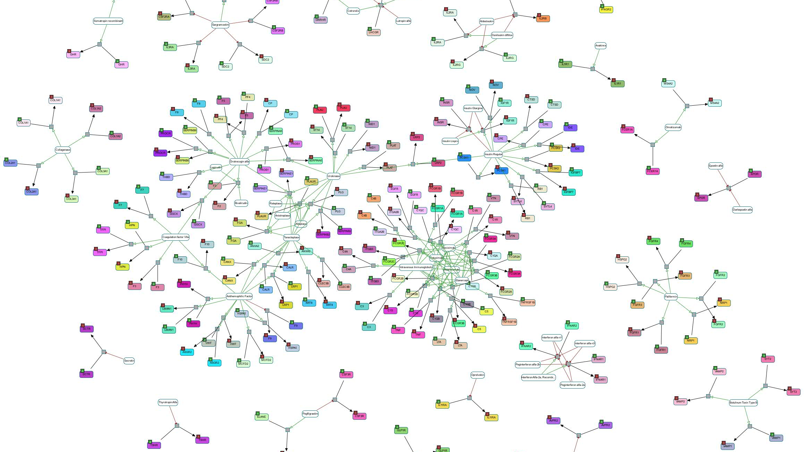

Predictive models on reactions
These information have been extracted from DrugBank.ca
The steps to extract:
Mapping the drugname in FDA database with DrugBank.
Extracting the ID from DrugBank for drugname in FDA.
Extracting target and pathway of drugs from DrugBank.ca
The first model is the predicted model for pneumonia not limited to diseases

Slide 46
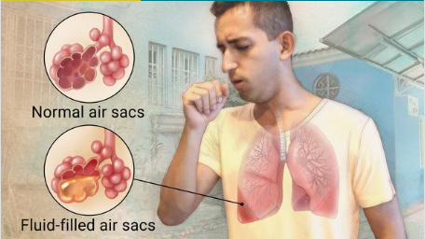
Predictive models on reactions (pneumonia)
Predictive having pneumonia reactions :
Rows that have pneumonia have been selected with a randomly selection of records not having pneumonia. A total of 102000 rows where 50804 records have pneumonia (Under Sampling).
Random forest has been trained on 90% of all available data and 10% of the records have been reserved for evaluation of the model.
The predictive model acquires 92% accuracy with following confusion matrix:
Actual | Prediction
 | No pneumonia | pneumonia
No pneumonia | 4593 | 507
pneumonia | 237 | 4844

Slide 47
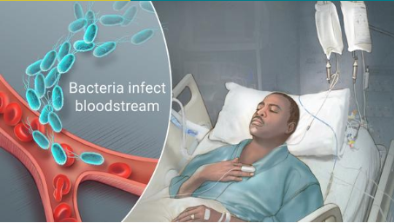
Predictive models on reactions (sepsis)
Predictive having sepsis reactions :
Rows that have sepsis have been selected with a randomly selection of records not having sepsis. A total of 53729 rows where 26729 records have sepsis (Under Sampling).
Random forest has been trained on 90% of all available data and 10% of the records have been reserved for evaluation of the model.
The predictive model acquires 95.8% accuracy with following confusion matrix:
Actual | Prediction
 | No sepsis | sepsis
No sepsis | 2579 | 121
sepsis | 95 | 2578

Slide 48
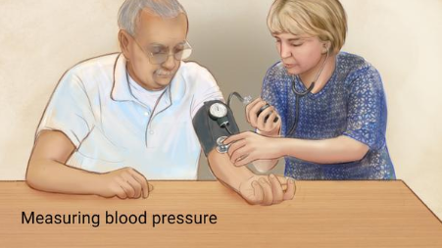
Predictive models on reactions (hypertension)
Predictive having hypertension reactions :
Records with hypertension (33410) along records with hypotension (32120) have been selected. The models is asked to classify them correctly using disease, age, gender, weight, pathway, and target (Under Sampling).
Random forest has been trained on 90% of all available data and 10% of the records have been reserved for evaluation of the model.
The predictive model acquires 95.4% accuracy with following confusion matrix:
Actual | Prediction
 | hypertension | hypotension
hypertension | 3216 | 125
hypotension | 188 | 3024

Slide 49
Predictive models on reactions

Slide 50
Predictive models on reactions
Predictive model on multiple reactions :
Reactions are:
Hypertension
Hypotension
Dehydration
Dizziness
Pneumonia
Pyrexia
Weight decrease
Anaemia
Predictive model is based on disease, age, gender, weight, pathway, and target.
Random forest has been trained on 90% of all available data and 10% of the records have been reserved for evaluation of the model.
The predictive model acquires 64.3% accuracy with following confusion matrix.
Note that multilabel classification usually reduce the accuracy.

Slide 51
Predictive models on reactions
Actual | Prediction
 | hypertension | hypotension | dehydration | dizziness | pneumonia | pyrexia | weight decrease | anaemia
hypertension | 1901 | 86 | 83 | 327 | 306 | 107 | 316 | 215
hypotension | 86 | 2115 | 259 | 145 | 93 | 103 | 225 | 186
dehydration | 104 | 279 | 1789 | 79 | 201 | 151 | 140 | 199
dizziness | 381 | 197 | 141 | 4578 | 407 | 248 | 175 | 152
pneumonia | 361 | 139 | 278 | 355 | 3003 | 485 | 286 | 200
pyrexia | 106 | 118 | 174 | 259 | 489 | 3341 | 134 | 201
weight decrease | 400 | 233 | 185 | 178 | 236 | 142 | 2484 | 177
anaemia | 237 | 193 | 235 | 121 | 158 | 183 | 175 | 2798
The bold numbers are the correct classified numbers while the rest are misclassified numbers.

Slide 52




